Slide 1
Lec 3: More Visualization Tools

Slide 2
Types of Charts

Slide 3
Bar Charts
We have already created some bar charts, but now let’s dive more deeply into this very simple but very powerful chart type.
Let’s Analyze Sales (double click) by Category (double click) and drill down to Sub-Category (drag to Columns, left of Category).
To make this easier to read let’s rotate it (click Swap in the toolbar) and sort it (click Sort icon).
This gives me a very nice look at Sales (in just a few seconds!). For example, Furniture (especially Chairs) seems to be selling well. But what about Profits?

Slide 4
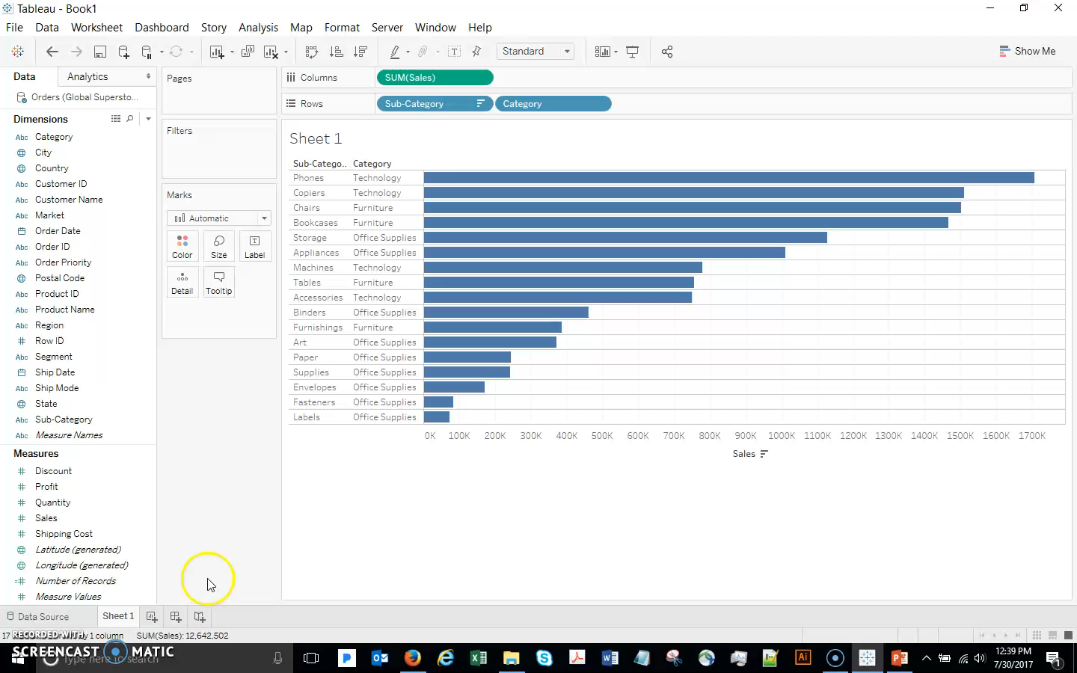
Bar Charts
Drag Profit out. Drop it and Tableau will use it on the Color shelf. It’s clear that Tables are not profitable – and I’m selling lots of them! Not good.

Slide 5
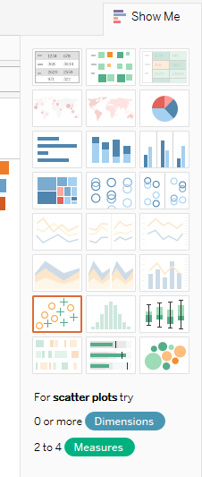
Bar Charts
Reminder: the Show Me pane provides other possibilities for visualizing the data I have selected – we can click a couple to see other options, but then let’s use the Back button to return to our bar chart.

Slide 6
Bar Charts
Now we see that there is a problem in Tables. Right-click Tables and select Keep Only.
It’s important to understand that this does not change the underlying data – the original sub-categories are still there. What this HAS done is created a new object (point it out in the dimensions pane).
Now that we’re just looking at Tables, let’s drill all the way down to the Product level. Drag out the Product Name to the viz and Sort descending.
Finally let’s look at the actual underlying data from our top selling product here. Click the first bar… View Data, Full Data tab. And now I have a nice list of transactions that I might want to investigate.

Slide 7
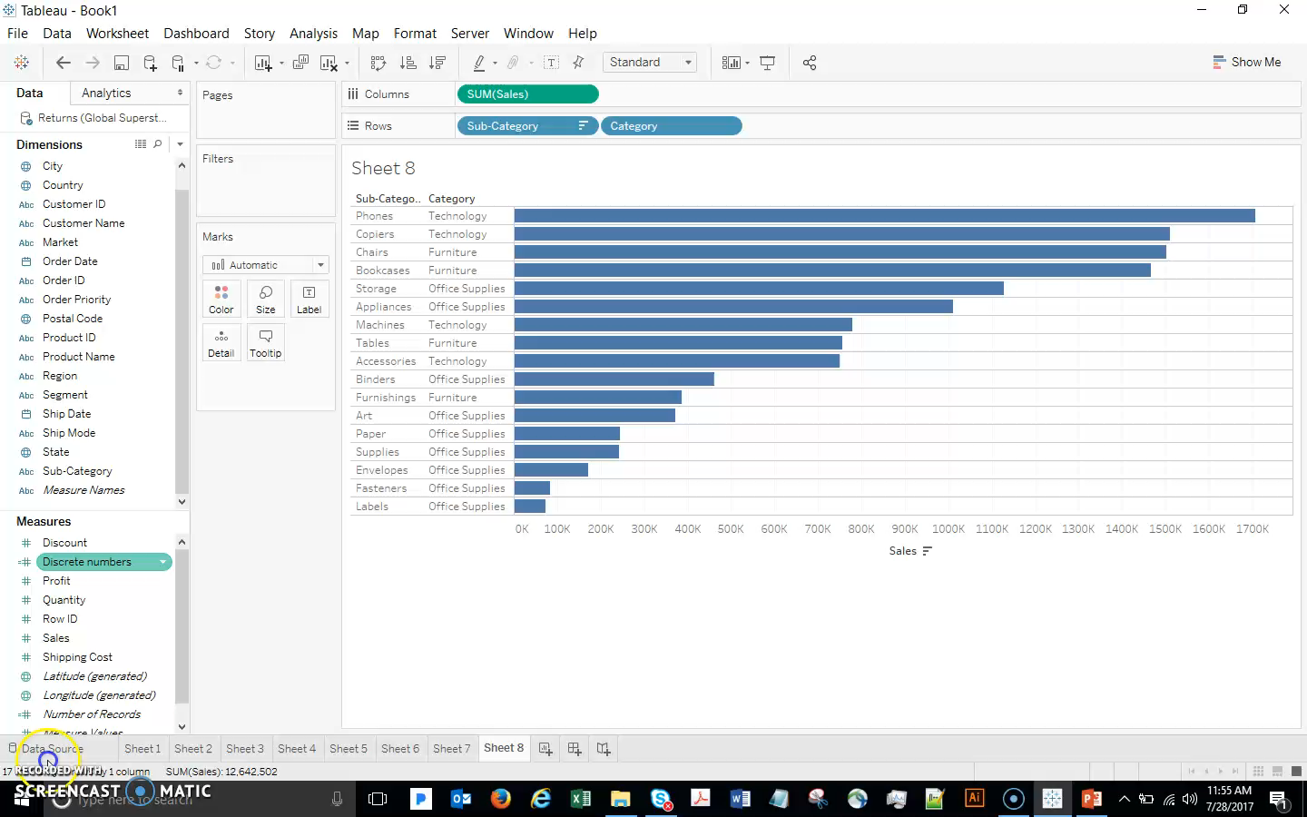
Bar Charts

Slide 8
Scatterplots

Slide 9
Scatterplots
Scatterplots are a very easy and powerful way to visualize the relationships between numeric variables (Measures). For example, I wonder if there is a relationship between Discount and Profit (seems like a reasonable possibility). Let’s take a look by selecting those two fields and clicking Scatterplot on the Show Me menu. Go to Analysis, uncheck Aggregate Measures.
Swap if needed to get Discount on the horizontal axis – looks like Profit tends to decrease as a larger Discount is given (confirms intuition).
Remember that with Tableau, unlike many other tools, we don’t need to stop here. It is very easy to keep adding data. For example, drag Segment to Color. This makes it easy to see what segment certain outliers belong to.

Slide 10
Scatterplots
If we prefer to focus on just one segment (while leaving all the data displayed), we can click Highlight Selected Values in the Legend and select, for example, to focus our viz on the Corporate segment by highlighting it.
Go back to viewing all the data. Go to the Analytics pane and drag out a trend line (choose linear). If you have had a statistics course, you probably realize that this is a regression line. We are not covering regression in this course, but for students who need a refresher, I have posted a document on the course website for you.

Slide 11
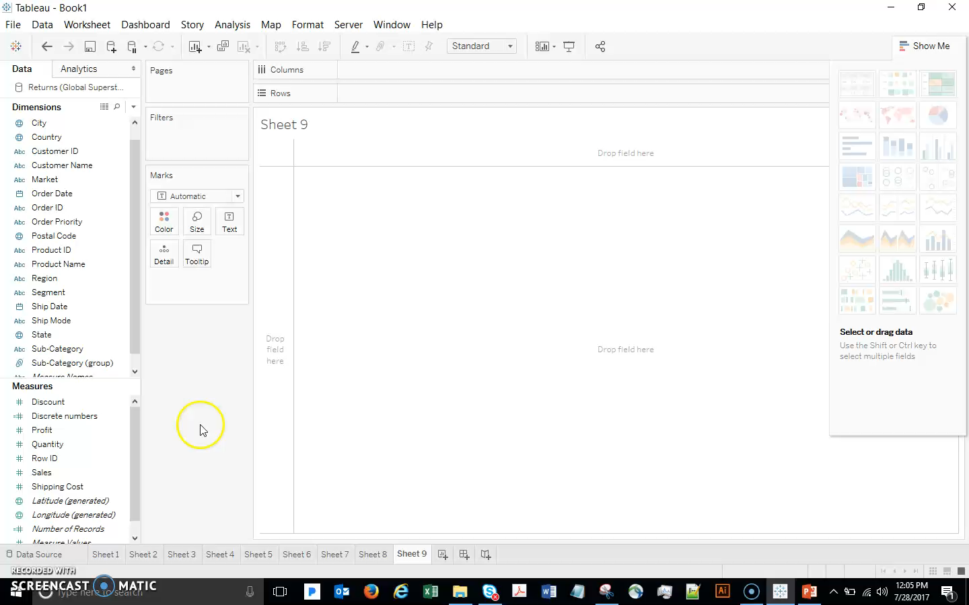
Scatterplots

Slide 12
Line Graphs

Slide 13
Line Graphs
Like Scatterplots, line graphs are good for looking at the relationship between 2 variables (although a scatterplot is often better for this). Line graphs are often used for looking at how something changes over time. This is called time series analysis.
Let’s start by looking at sales over time. Double-click Sales, double-click Order Date. Tableau understands date fields and automatically breaks them down by Year, Quarter, etc.
I actually need more detail than yearly sales results, so let’s expand to Quarter and then Month. I don’t really care about Quarter, so drag it out of the viz.
Note that dual axis is very easy in Tableau – drag Profit to the right axis. Then Undo to get back to Sales only.

Slide 14
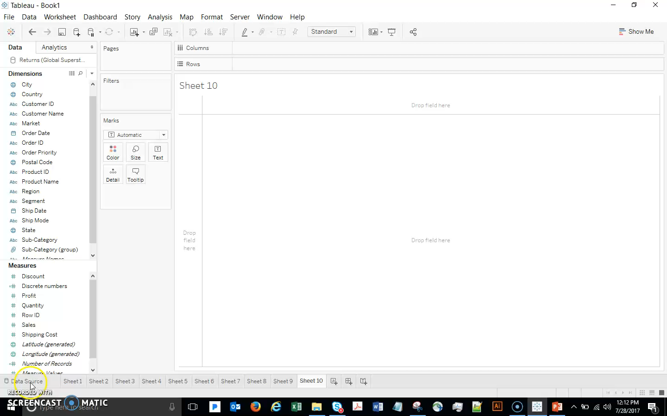
Line Graphs

Slide 15
Line Graphs
Remember that we can now drag things around and change the viz on the fly. We have discrete dates right now (we have already learned how, with discrete dates, each part of the date is treated separately). So for example we can drag Year to Color and see direct comparisons between the years. (Note that, if you liked the current format and just want each year to be a different color for clarity, you could CNTRL-drag Year to color).

Slide 16
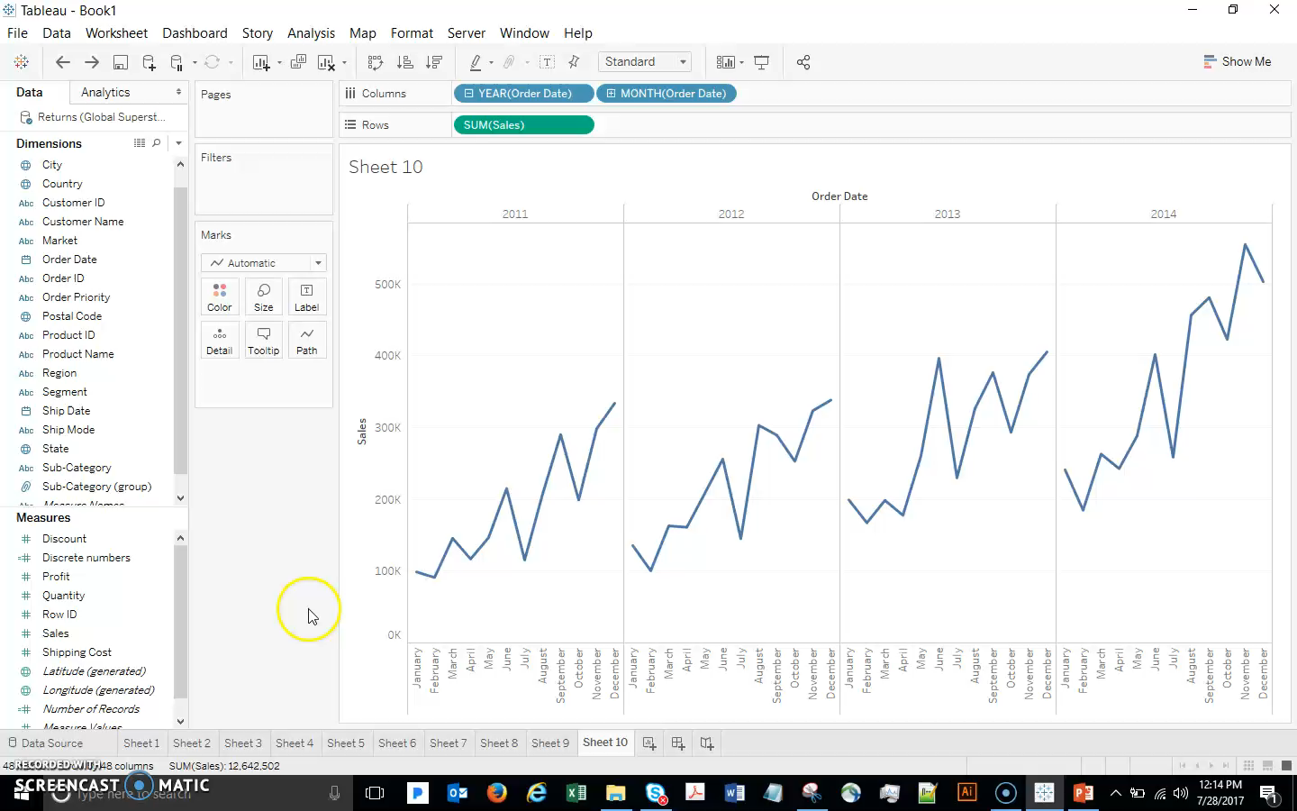
Line Graphs

Slide 17
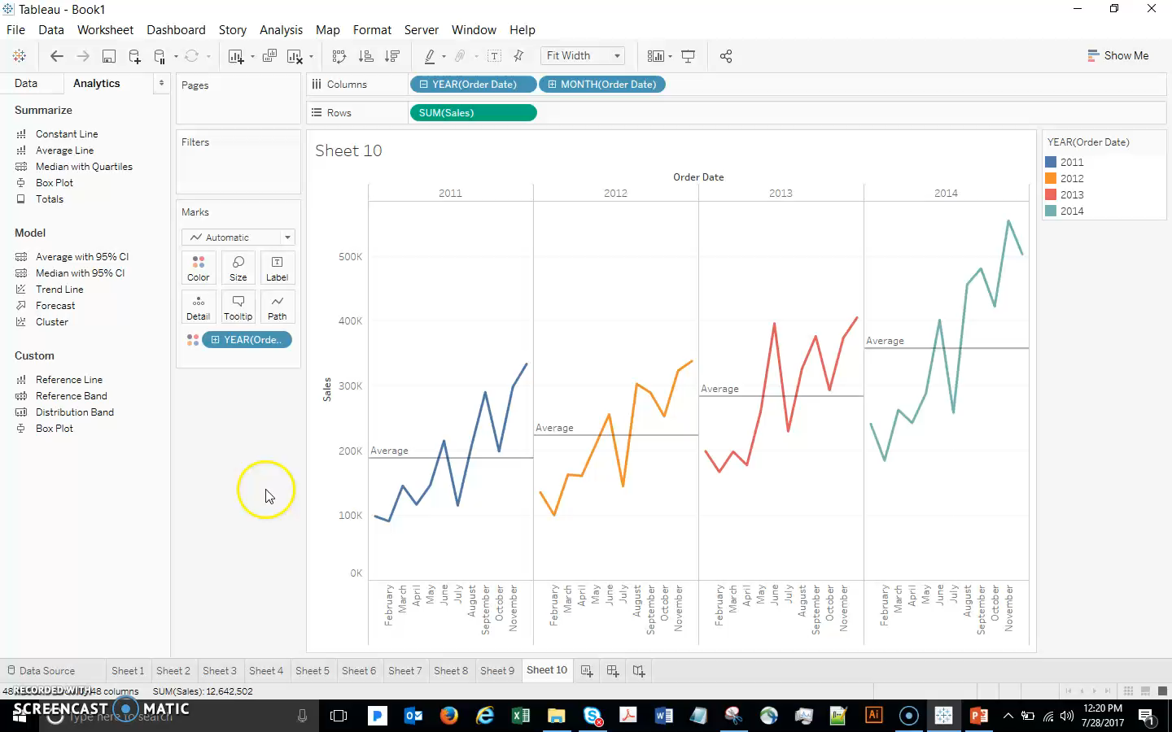
Line Graphs
Although we are talking about line graphs, I want to briefly point out how easy it is to explore other options: click the drop-down in the Marks card and select Bar, then Circle, and then finally leave it as Area.

Slide 18
Histograms

Slide 19
Histograms
Double click Discount. The default is a bar chart, and we can add more data to break out discount by segment, etc. But what if we are just interested in learning more about the various discounts that we offer?
Use Show Me to change to Histogram. Right-click the new Discount(bin) dimension, Edit, and change bins to 0.1. This is a very quick and easy way to get the view of the data that we want! Now we can see that most discounts are between 0 and 10%, and there are also a lot of discounts in the 10-20% range. We even have 300 instances in which the discount given was 70-80% (shown in the Tooltip). If we are suspicious about these, it just takes a couple clicks to get to the underlying data (right-click that bar and show the data).
Remember that, since this is Tableau, we can add more data if we want – for example, drag Category to Color, then Undo this change.

Slide 20
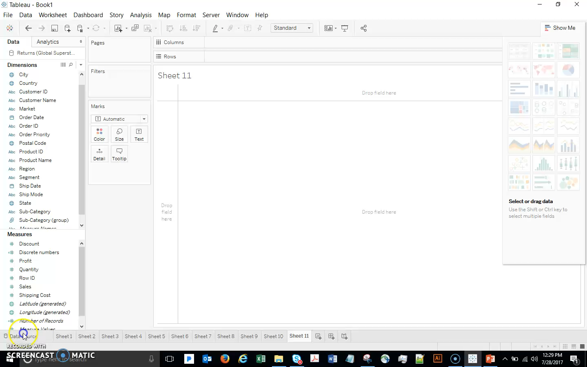
Histograms

Slide 21
Heat Maps

Slide 22
Heat Maps
Let’s use heat maps to visualize the margin that we are making on Furniture items. Notice that margin is not in the data - let’s do a quick preview of Calculated Fields to create the margin field (we will cover calculations in detail in a later topic):
Analysis…Create Calculated Field. Name it Margin, formula is SUM([Profit])/SUM([Sales])
Drag Category and Subcategory to Row
Drag Order Date to Columns, and then change to Month (discrete)
Drag Category to Filter shelf, and select only Furniture
Finally, drag your new Margin field to the viz. We have a table of numbers. Not the most user-friendly…

Slide 23
Heat Maps
Select Heat Map from Show Me, and then drag AGG(Margin) on the Marks card to Color. Change color to Orange-Blue Diverging. Drag edges if needed to make the viz larger. This is much better than the table of numbers! We immediately see some insights – e.g. maybe we are selling tables as a loss leader and making it up on chairs?

Slide 24
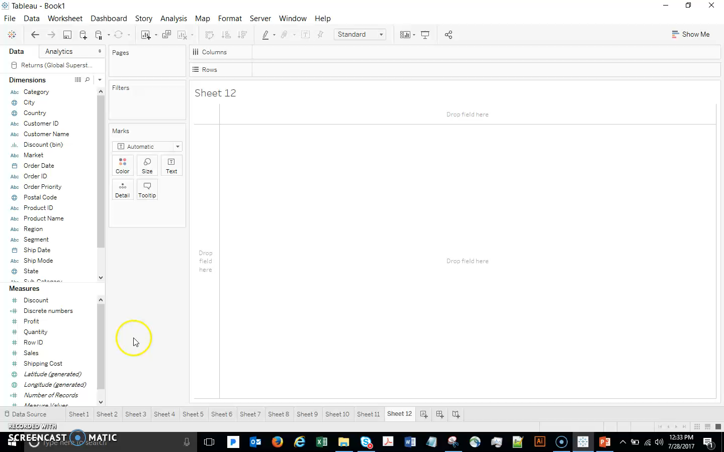
Heat Maps

Slide 25
Getting Started with Data

Slide 26
Connect to Data Screen

Slide 27
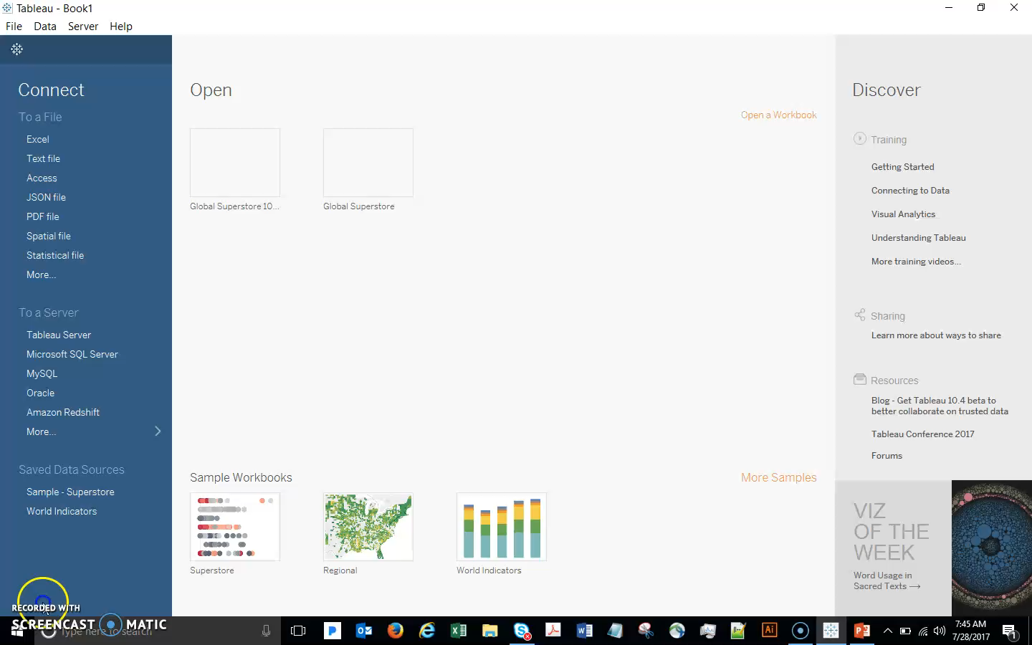
Connect to Data Screen
To connect to the Superstore file, click on Excel, navigate to where you saved the file and click open.

Slide 28
Connecting to Tableau

Slide 29
Connecting to Tableau
Now Tableau brings us to the data connection window.
Here we can see the name of the file – and here we can click to rename the connection if desired
Down below, we can see all the sheets in the Excel file.
Sheets in Excel are treated the same as tables in databases, and we can choose to connect to a single table or join multiple tables.
Simply drag a sheet into the data connection canvas.
Tables can be renamed simply by clicking on the name. The gear icon brings up options related to the data source.
We can see the data down in the preview pane.

Slide 30
Connecting to Tableau
There’s a lot we can do on this screen (we will go over each of these in detail later in the class):
If our column names aren’t ideal, we can click on the drop down arrow to the right of the name and select rename.
Clicking on the data type icon allows us to change the default data type for that column.
If a field contains data that is concatenated, like Order ID and we’d like to split it, we can do that with the Split option – either custom or automatic.

Slide 31
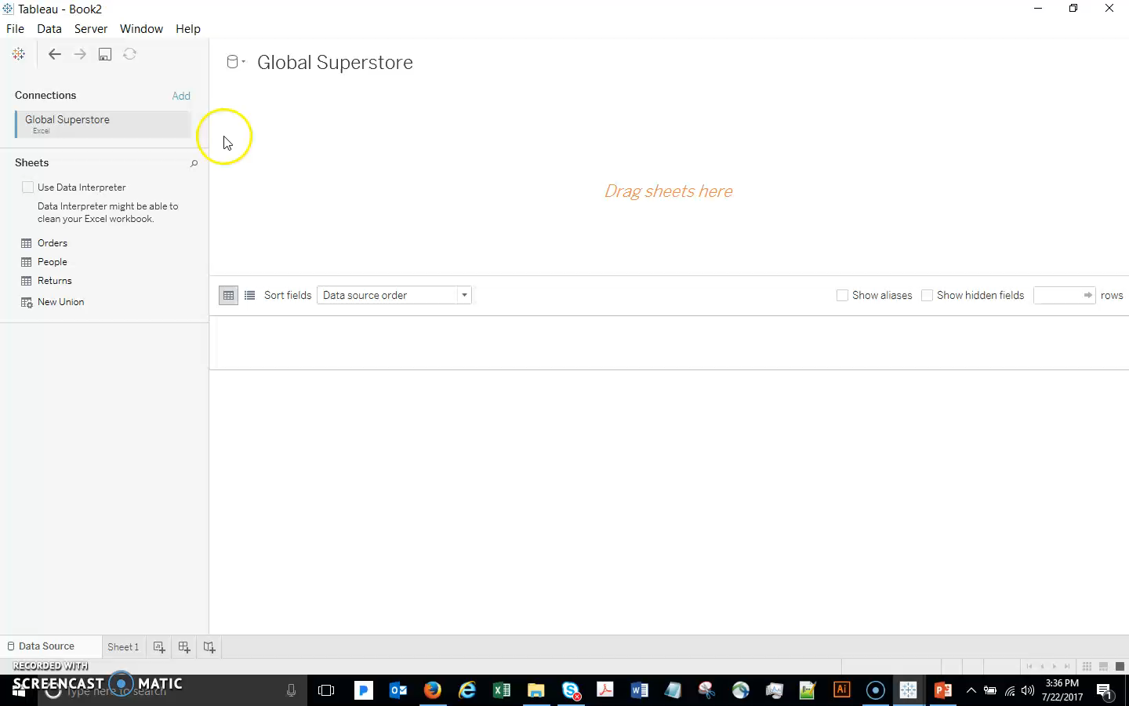
Connecting to Tableau

Slide 32
Live versus Extract

Slide 33
Live versus Extract
Something to consider before we begin analyzing our data is if we want to connect live or extract.
Connecting live leaves the data in the database or source file.
This is best when we want to leverage a high performance database’s capabilities, or to get up-to-the-second changes in data visualized in Tableau.
A live data connection means that Tableau sends queries to your database and retrieves up to date data whenever the Tableau dashboard is updated.
A live data connection is best and should be used when the live connection
between the Tableau dashboard and your data is possible.
That being said, sometimes connecting live can result in a slow experience, depending on the database.

Slide 34
Live versus Extract
The other option is to extract the data into Tableau's high performance in-memory data engine.
Which means that Tableau sends queries to your extracted or static database and not the underlying data.
Any updates to the underlying database will not update the Tableau dashboard. You will have to refresh the Tableau extract to get the up-to-date data.
TDE should be used when a live connection to your data is not possible, when the live data connection is too slow, or in such cases where the size of the data is extremely large.
In general, TDE should be used when your data is located on your own computer, a real data feed to your dashboard is not needed and when the data size is sufficiently large

Slide 35
When to use Live or Extract?
A Tableau data extract is recommended when your database is too slow for
interactive analytics
or when you need to be offline and will not always have an internet or network connection to your data.
A live connection is recommended when you have a fast database or when you need up to the minute
Bus schedules
Currency exchange

Slide 36
Connecting to Multiple Tables

Slide 37
Connecting to Multiple Tables
Next, what if we realize we need to bring in additional data?
To add columns from other tables in the same data source (i.e. other worksheets in our Excel file), we need to edit our data connection.
To do so, click on the Data Source tab.
Let’s join our returns table to the orders table.
Double click or drag out Returns.

Slide 38
Types of Tables Joining
Table A
Table B
id | First name | Last name
1 | Aaron | Cab
2 | John | Smith
3 | Clark | Kent
6 | Barry | Allen
id | Age | Place
1 | 30 | CA
2 | 22 | OH
3 | 33 | DC
5 | 11 | CE
Inner Join
id | First name | Last name | Age | Place
1 | Aaron | Cab | 30 | CA
2 | John | Smith | 22 | OH
3 | Clark | Kent | 33 | DC

Slide 39
Types of Tables Joining
Table A
Table B
id | First name | Last name
1 | Aaron | Cab
2 | John | Smith
3 | Clark | Kent
6 | Barry | Allen
id | Age | Place
1 | 30 | CA
2 | 22 | OH
3 | 33 | DC
5 | 11 | CE
Left Join
id | First name | Last name | Age | Place
1 | Aaron | Cab | 30 | CA
2 | John | Smith | 22 | OH
3 | Clark | Kent | 33 | DC
6 | Barry | Allen | Null | Null

Slide 40
Types of Tables Joining
Table A
Table B
id | First name | Last name
1 | Aaron | Cab
2 | John | Smith
3 | Clark | Kent
6 | Barry | Allen
id | Age | Place
1 | 30 | CA
2 | 22 | OH
3 | 33 | DC
5 | 11 | CE
Right Join
id | First name | Last name | Age | Place
1 | Aaron | Cab | 30 | CA
2 | John | Smith | 22 | OH
3 | Clark | Kent | 33 | DC
5 | Null | Null | 11 | CE

